Slide 1


SecureBank Pro
Data Hiding & Secure Banking System Architecture
Computer Science Department

Slide 2




Introduction: Why SecureBank?
The Problem
The Solution
Standard beginner projects often leave variables `public`. In a financial system, this allows direct data manipulation.
A Java-based system built strictly on OOP principles. Data is hidden, access is heavily restricted, and modifications require strict validation.
Without architectural boundaries, unauthorized transactions, negative balances, and data corruption are inevitable.
It acts like a real-world API, where the object protects its own state.

Slide 3









System Core Modules
Secure Auth
Transaction Guard
Audit Logging
Encapsulated user credentials ensure passwords are never exposed directly, using protected getter methods.
Setters include deep validation to block negative amounts and ensure sufficient funds before execution.
Every validated transaction is written to an immutable text file to maintain an accurate history.

Slide 4

OOP Concepts in Practice
How Java architecture secures the data flow

Slide 5

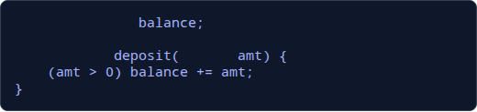
1. Data Hiding & Encapsulation
The First Line of Defense
By declaring `balance` and `accountNumber` as private, we remove direct access. The variables become invisible to external classes.
Changes can only occur through controlled public methods (Setters) that act as security checkpoints.
private
double
public void
double
if

Slide 6








2. Inheritance & Polymorphism
BaseAccount (Parent)
SavingsAccount (Child)
CurrentAccount (Child)
Holds common protected fields like `accountID` and `ownerName`. Defines abstract method `calculateFee()`.
Inherits base fields. Overrides `calculateFee()` to implement zero monthly fees but strict withdrawal limits.
Inherits base fields. Overrides `calculateFee()` to apply standard monthly transaction charges.

Slide 7

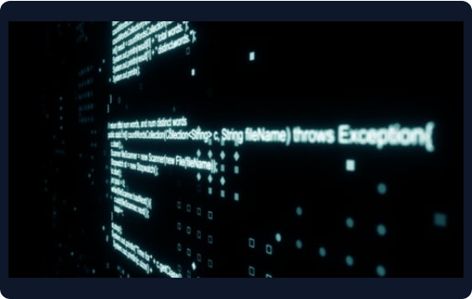
3. Exception Handling
Graceful Failure: System doesn't crash upon invalid input. Custom exceptions handle the logic.
InsufficientFundsException: Triggered during withdrawals if `amount > balance`.
InvalidTransactionException: Thrown immediately if a negative deposit is attempted.
Secure Trace: Exceptions log the unauthorized attempt time to the console without exposing data.

Slide 8

Impact of Access Modifiers
Strict Boundary Control
0%
By enforcing the rule that no state variable is public, the surface area for logic errors and malicious tampering drops to zero.
Private keeps data isolated. Protected allows inherited classes to function smoothly. Public is strictly reserved for safe, validated behavior methods.
Direct Variable Access

Slide 9

4. File I/O & Persistence
Immutable Audit Logs
Memory is volatile. To simulate a real bank, all validated actions are serialized and appended to `audit_log.txt`.
Using Java's `FileWriter` and `BufferedWriter`, every login, deposit, and failed security attempt is permanently recorded.
Keeps historical state safe.
Allows for offline auditing.

Slide 10
Architecture Comparison
Feature | Standard Project (Unsafe) | SecureBank Pro (OOP)
Variable Scope | Public / Default | Strictly Private
Data Modification | Direct Assignment (`x = y`) | Through Setters & Validation
Negative Deposits | Accepted (Bugs) | Blocked & Logged
Transaction History | Erased on Close | Saved via File I/O

Slide 11








Technology Stack
Java SDK
Java I/O
Exceptions
Core object-oriented logic, utilizing classes, interfaces, and polymorphism.
File handling for data persistence, reading and appending logs securely.
Custom try-catch blocks to prevent system crashing and ensure stability.

Slide 12

Questions?
Thank you for your time and attention.

Slide 13



Image Sources
https://static.vecteezy.com/system/resources/previews/060/580/161/non_2x/futuristic-digital-shield-with-glowing-blue-padlock-icon-representing-cybersecurity-and-data-protection-free-png.png
Source: www.vecteezy.com
https://elements-resized.envatousercontent.com/elements-video-cover-images/files/237864983/Java%20Coding%20590x.jpg?w=500&cf_fit=cover&q=85&format=auto&s=9a6e24a6cd44a7a1c5c459237aa20b2d48b496c9935cd56090063ed0be14b80a
Source: elements.envato.com
https://media.istockphoto.com/id/1495307294/vector/digital-banking-global-networking-cyber-security-concept-in-futuristic-glowing-low-polygonal.jpg?s=1024x1024&w=is&k=20&c=UdEtHu3cH8GIvx-ljvCatFUJlCp-kv7Jpmfxgt1PKuI=
Source: www.istockphoto.com

